Slide 1
Propel
Innovation enabled

Slide 2
What is Propel? The Deutsche Bank Account Innovation workstream
Example Experiment #1
HYP: Clients depend on applications with limited documentation or developer knowledge of *IBOR-related activity in the codebase that will need remediation.
TEST: Can we use an innovate bug-finding tool to identify instances of *IBOR-related code that will need remediation without laborious and error-prone, manual code scanning.
The Client Value Board is DXC’s mechanism for ensuring that it is developing the right solutions to service Deutsche Bank effectively on a Domain by Domain basis
Propel is the innovation accelerator and incubator that allows DXC and Deutsche Bank to test technologies and concepts outside the typical constraints experienced in a large enterprise
The benefit to Deutsche Bank is the experimental approach (faster, lower cost, reduced risk) in finding solutions to problems then scaled to production standards
The benefit to DXC is to get a better forward-looking view of the direction of travel to pre-empt the services/skill/technologies needed to better serve Deutsche Bank in the best way possible
Example Experiment #2
HYP: Insider threat detection often happens after the activity is identified. An enterprise that can intercept potentially malicious activity and prompt an authentication event can protect their organization from reputational and commercial impact and also improve employee user experience by reducing false positive/access denied events
TEST: Integrate an innovative Multi-Factor Authentication solution and an advanced explainable AI product to detect anomalous user behavior in the corporate estate and route actions appropriately (SOC, Auth event, Access Denied etc)

Slide 3
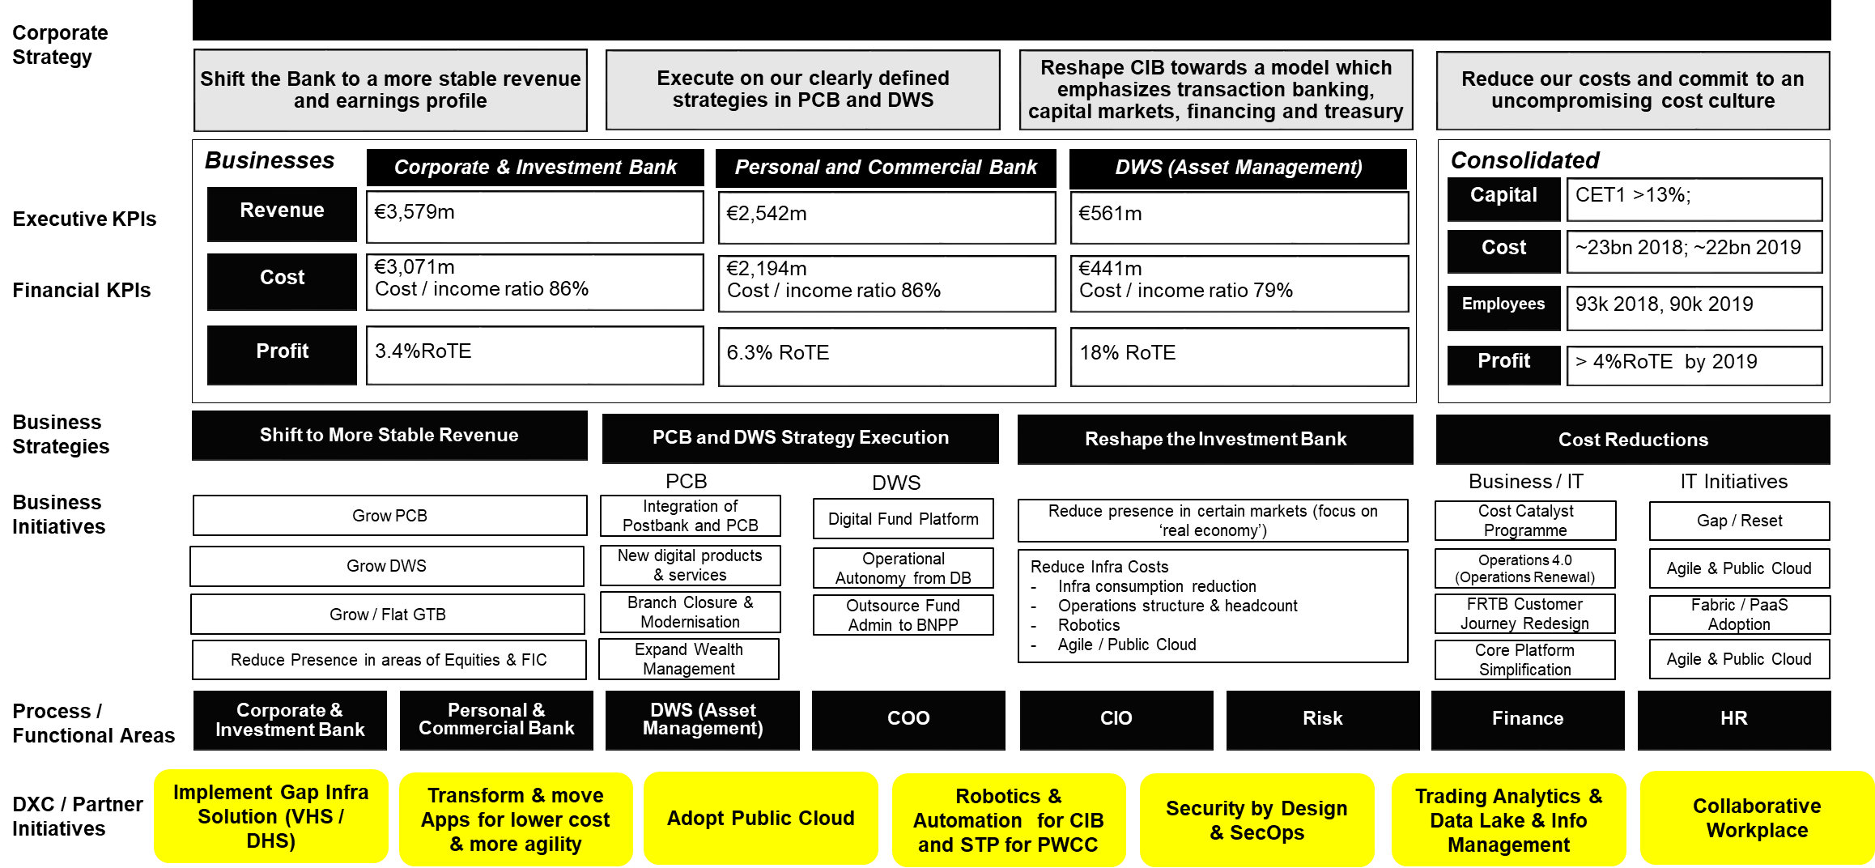
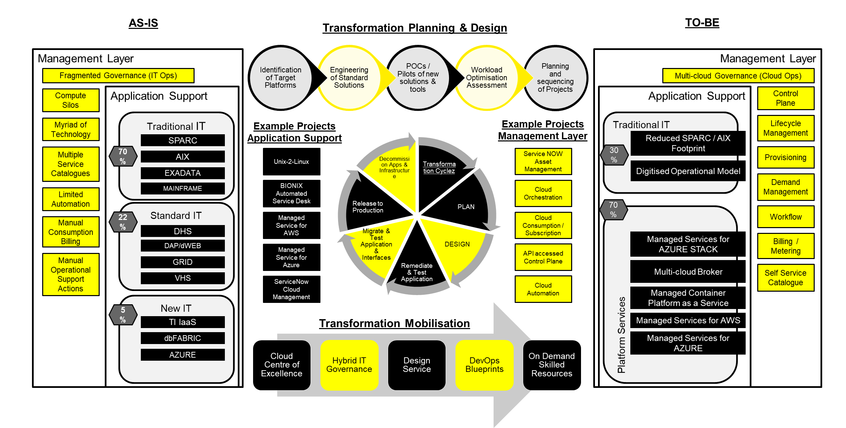
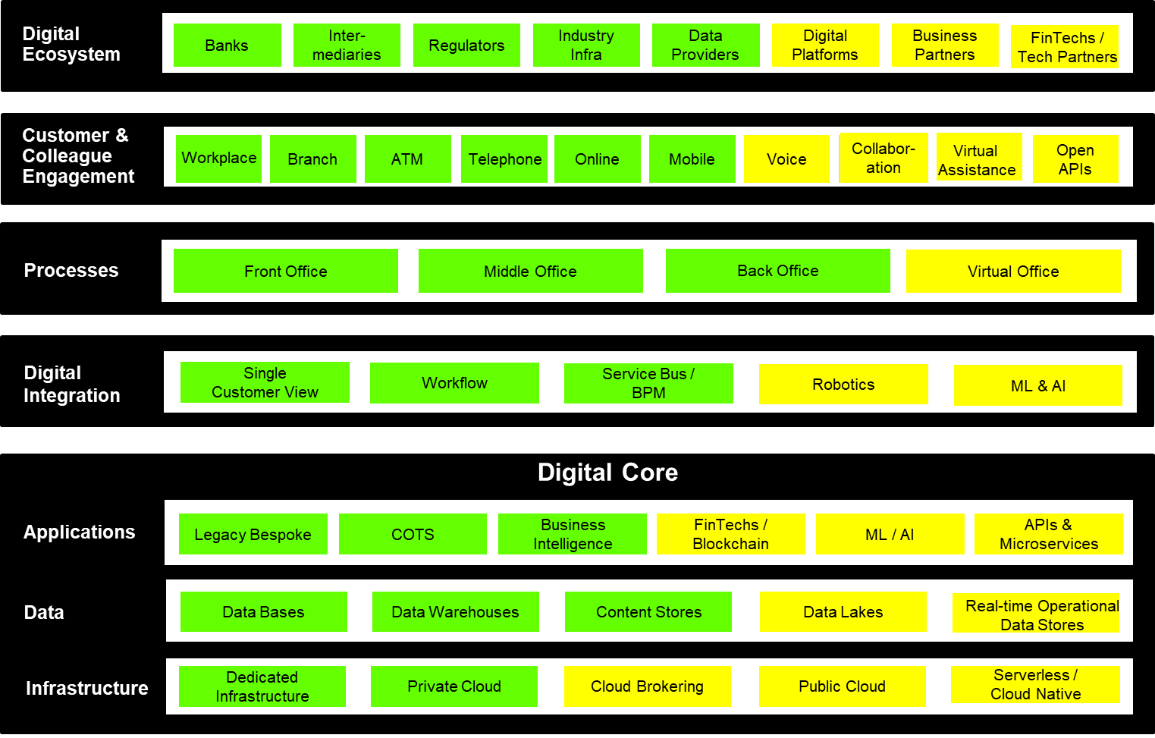
Where Propel sits in the DB Account
Propel
DXC / Client Innovation Ecosystem
Policies
Deutsche Bank
Regulation
DB Redbook
Deutsche BVF
DXC Initiatives
Domain Playbooks
T-Maps
Account Technical Strategy / Principles
informs
Technical Risk Register
Client Value Board

Slide 4
Making Propel work
Governance and Communication (Propel Council)
Demand
Supply
Transformation
Key Steps
Proactively Engage, Inform and Coach Client Innovation leads
(inception phase)
Ideas documented in backlog for further assessment
(3-day sprints)
Medium to high fidelity prototypes, assessed, tested with users
(3-week or 3-month sprints)
Extensive market testing of concepts & prototype testing production systems
(Transitional)
Product is scaled and rolled out to market(s) with owner
(Commercially GTM-ready)
Engage & Inform [2/5]
Ideate and Qualify [1/5]
Experiment [1/5]
Accelerate [0/5]
Scale [0/5]
Ideation Funnel
Answering the ‘WHAT”: Ideas are prioritized, tested and finalized as they go through the funnel
Explore / challenge
Build > test > learn
Build > test > learn
Build > test > learn
(DXC + Client)
(DXC)
(DXC + Client via LIC or DEL)
(Transition to Client or build to
scale in DXC)
(Informs Corporate supply chain)
Volume of
Experiments
Quality Assurance and Value Attainment
Clarity around
Client/DXC Value
Research and DXC SME Insight
Partnerships and Ecosystem Support
Kill / Keep stage gates
New Technology and Strategic Partner R&D
Startup/xTech Community Insight & Management

Slide 5
What’s next?
Seeking partnership with Deutsche Bank colleagues to help validate and triage the experiment backlog
Help enhance the backlog with usecases and problem statements that Deutsche Bank will see benefit from solving
Identify stakeholders within Deutsche Bank to act as Product Managers for those experiments identified for progression
Develop a dialog and deepen the relationship between the DXC and Deutsche Bank Innovation communities – Ideally Deutsche Bank representation on the Propel Council
Investigate the opportunity to run an Industry Innovation Showcase for Deutsche Bank colleagues in the London Innovation Centre in DXC HQ, Kings Cross
Contact: scott.brown3@dxc.com

Slide 6
The Propel manifesto
How we hold ourselves accountable for the outcomes of the innovation agenda
1
Focused pipeline management
Experiments transparently managed and regularly reviewed by the Propel Council ensuring they align with strategic business objectives outlined in the Client Business Value Framework
5
Outcome obsessed
We are clear from the start what success will look like and will agree accountability to scale and realise benefits as part of the idea development process
2
Work must be problem-specific and user focused
We will put the Client at the centre of every initiative that is put forward and we must be able to explain ‘What specifically is the problem we are trying to solve?”
6
An iterative, flexible process
Things change. We will remove unnecessary work and quickly move to finalized propositions by using repeatable steps in a simple to follow plan
3
Emphasis on validated learnings
Diligence in the early phase of an experiment pays off – the Propel Council will assess every proposal with 3 lenses – client desirability, business applicability and technology feasibility (subject to ratification by Council)
7
Effective multi-disciplinary teams
A joint sales, technology and innovation team with multidisciplinary skills, each with a stake in the outcome of the experiment, will remain involved from start to finish, not just for one phase of the project.
4
Fail well
Not all experiments succeed and some won’t proceed. We have stage gates that are placed at the most strategic points of the process to validate investments and support fact and outcome-based decision making
8
A methodology that will continue to evolve
Every project is executed better than the one before. Continuous learning and improvement is a key facet of our approach, with post-mortems, reviews, and feedback built into the process.

